Slide 1
CAPE Academy
Osceola Fundamental High School

Slide 2
Three CAPE Academies
CTED
Culinary
Engineering
Academies of Distinction

Slide 3
What is an Academy?
CAPE ACT
Career and Professional Education Act
Allows for funding for CTAE Programs
Requires:
Pathways aligned with local industry
Industry Certifications
Advisory Board
“The Florida Career and Professional Education Act was created to provide a statewide planning partnership between business and education communities, to expand and retain high-value industry, and sustain a vibrant state economy.”

Slide 4
Advisory Board
Meets 6 times a year
Comprised of:
Industry representatives
College professors
OFHS teachers
Administrators
Parents
Advisory Board Goals:
Advise c.TED throughout the year helping align courses with industry standards, expectations, and protocols
Provide opportunities for students in work-based learning
Assist in FBLA and other various related c.TED events throughout the year

Slide 5
Pathways
Cyber Security**
Digital Design**
Digital Video/TV Production
Sports Marketing & Entertainment Marketing**
Web Development and Design**
Business Management and Analysis**
Computer Science Principles**
**Pre-requisite – Digital Information Technology**

Slide 6
Other Courses
AP Computer Science Principles
AP Computer Science A & B
OJT

Slide 7
Digital Information Technology
PREPARE
STUDENTS
FOR THE WORLD OF WORK WITH HIRABLE SKILLS!
FOR CAREERS
THAT DON’T
EXIST YET!
Presentations
Career Exploration
Resumes/Cover Letters
Business Documents
Soft Skills
Professional Dress
A little bit of:
Web design
Graphic Design
Networking/Computer Science

Slide 8
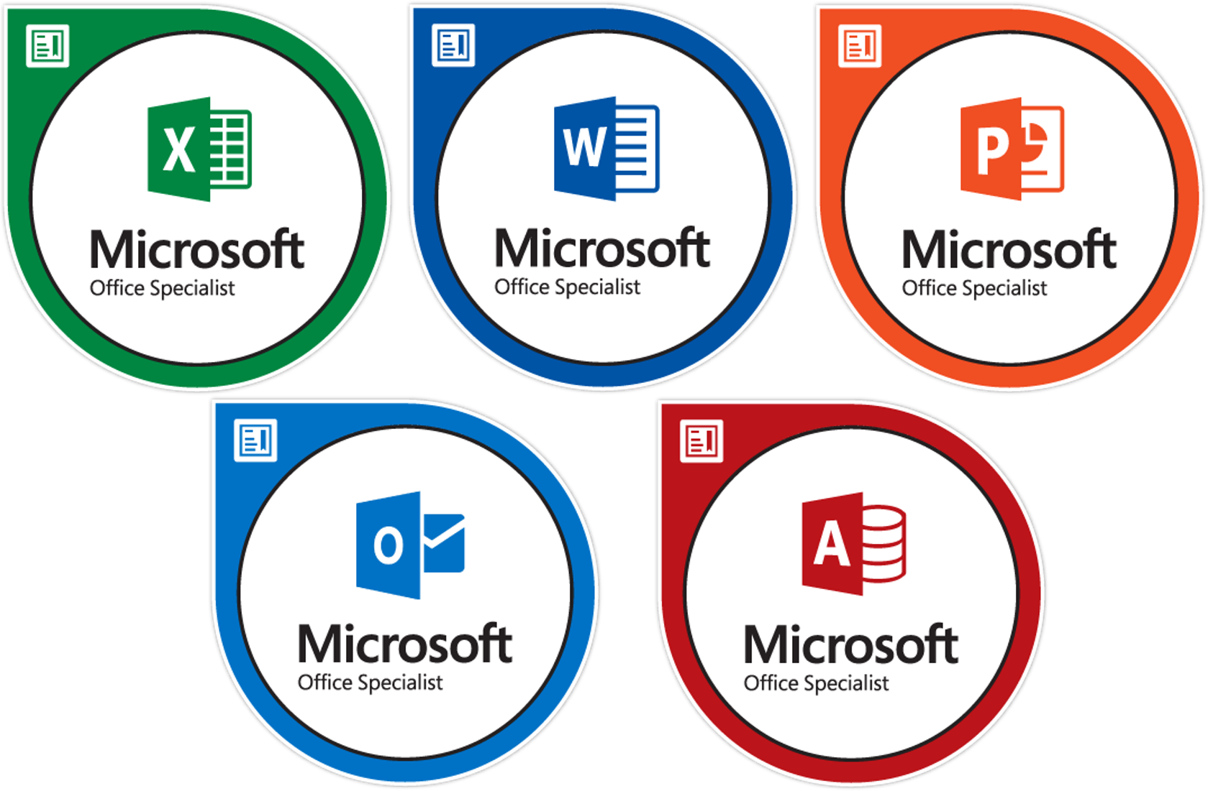
Industry Certifications

Slide 9
Digital Information Technology
Meets Graduation Requirements:
Practical/Fine Arts
Online*
Math/Science credit!*
*Must Pass Bundle Certification – Word, Excel, PowerPoint*

Slide 10
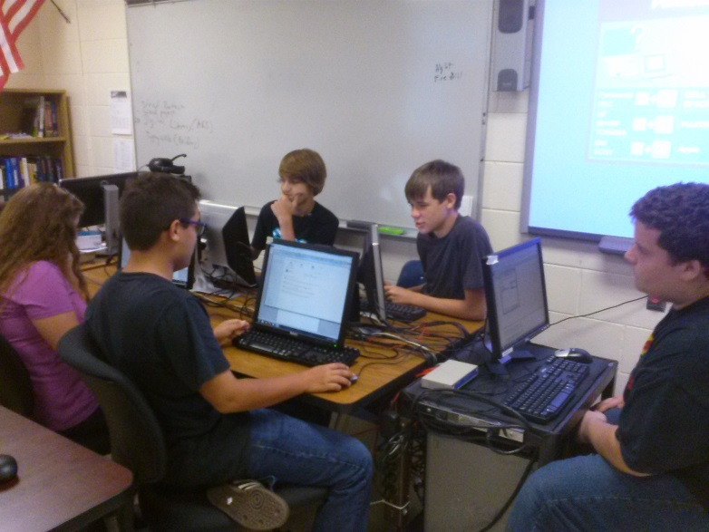
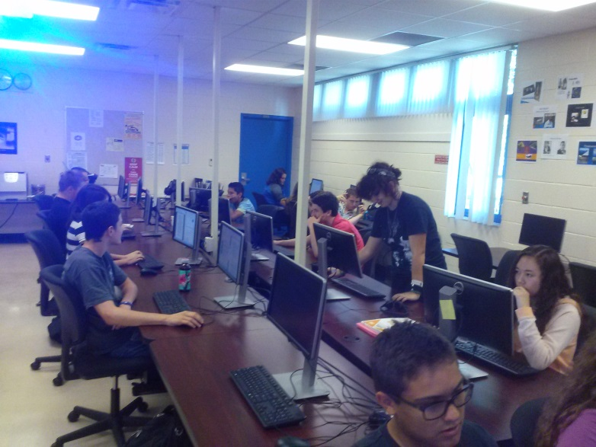
Applied Cyber Security Pathway *
Computer and Network Fundamentals
Security Fundamentals
Operational Cyber Security

Slide 11
Computer Science Principles Pathway *
Foundations of Programming
Procedural Programming
Object-Oriented Programming Fundamentals
(Industry Certifications – include Python, Javascript and Java

Slide 12
Digital Design Pathway
Adobe
InDesign
Illustrator
Photoshop
Logo/Branding
Illustrations
Publications
Commercial Art

Slide 13
Sports Marketing Pathway
Sports, Recreation, and Entertainment Essentials
Sports, Recreation, and Entertainment Applications
Sports, Recreation, and Entertainment Management

Slide 14
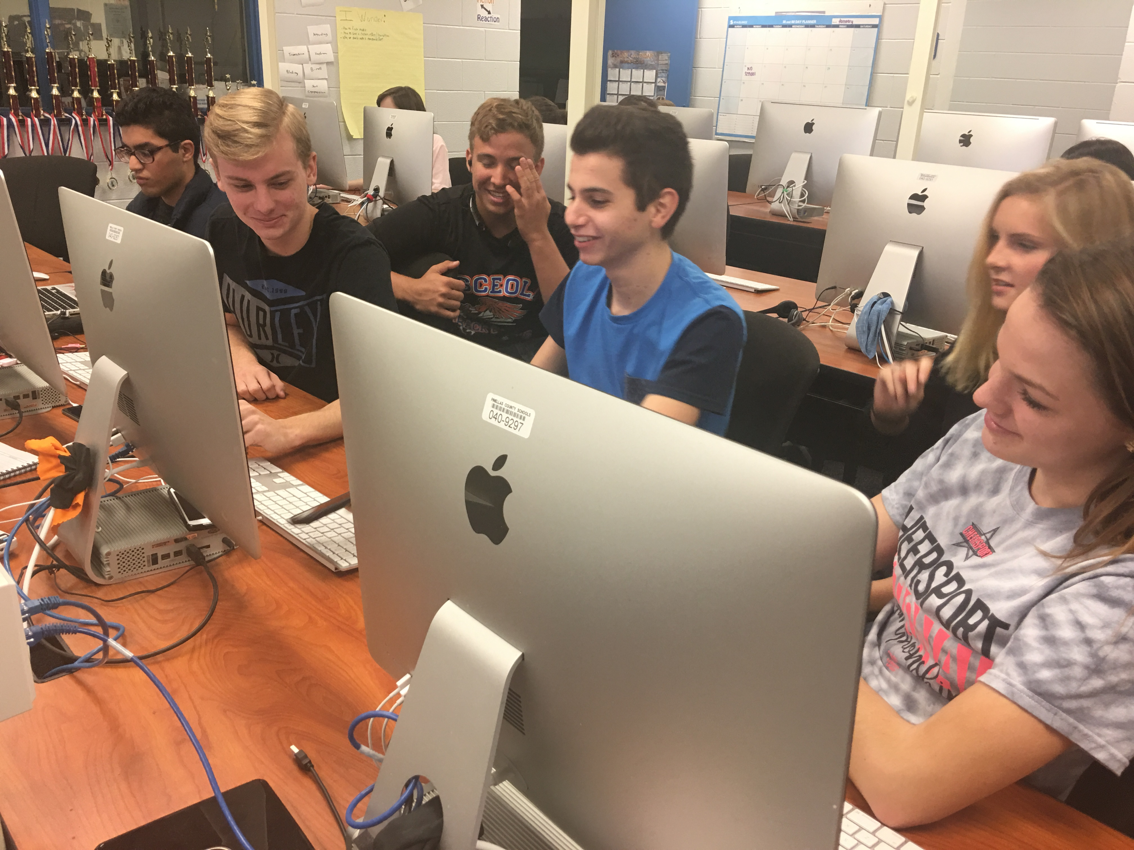
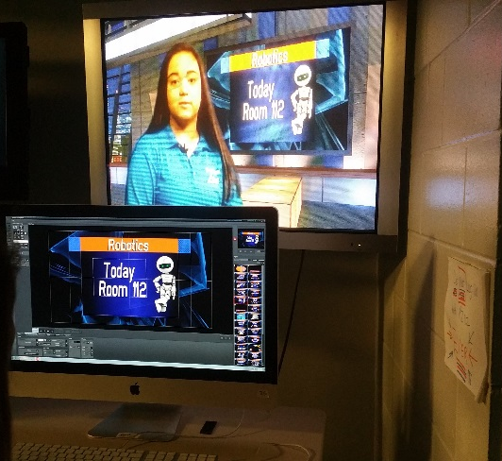
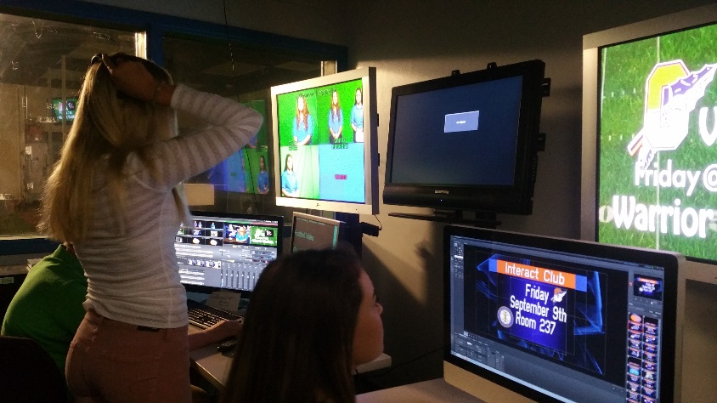
Digital Video Pathway
Digital Video Technology1-6
Live Morning TV Show
Award Winning!

Slide 15
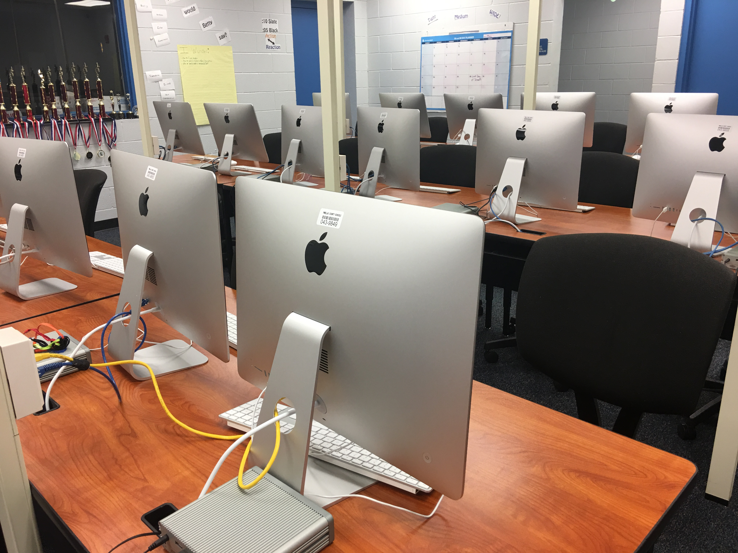
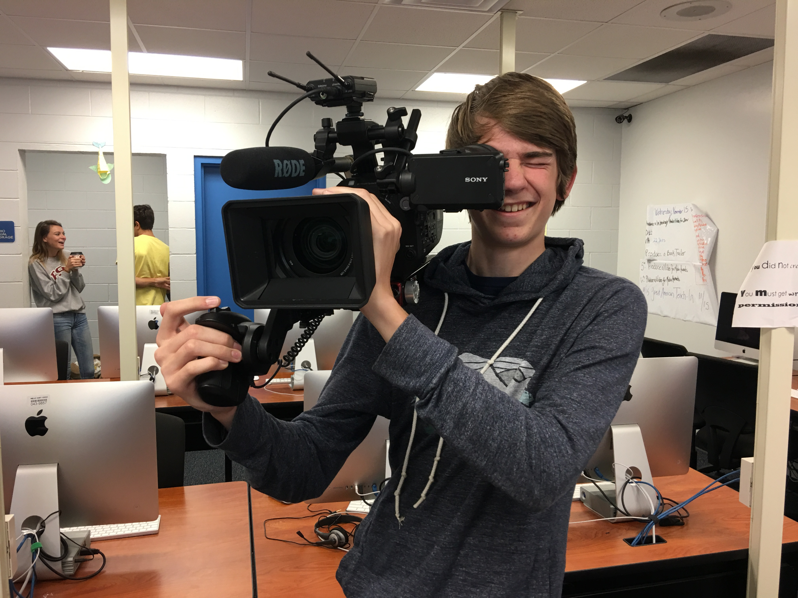
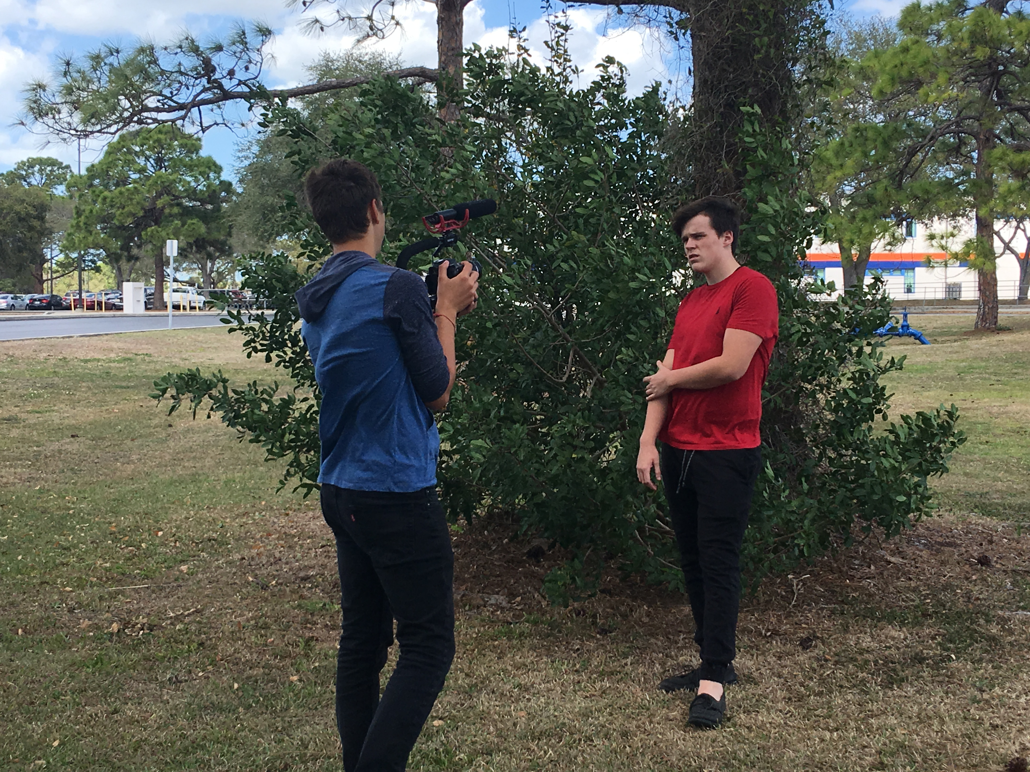
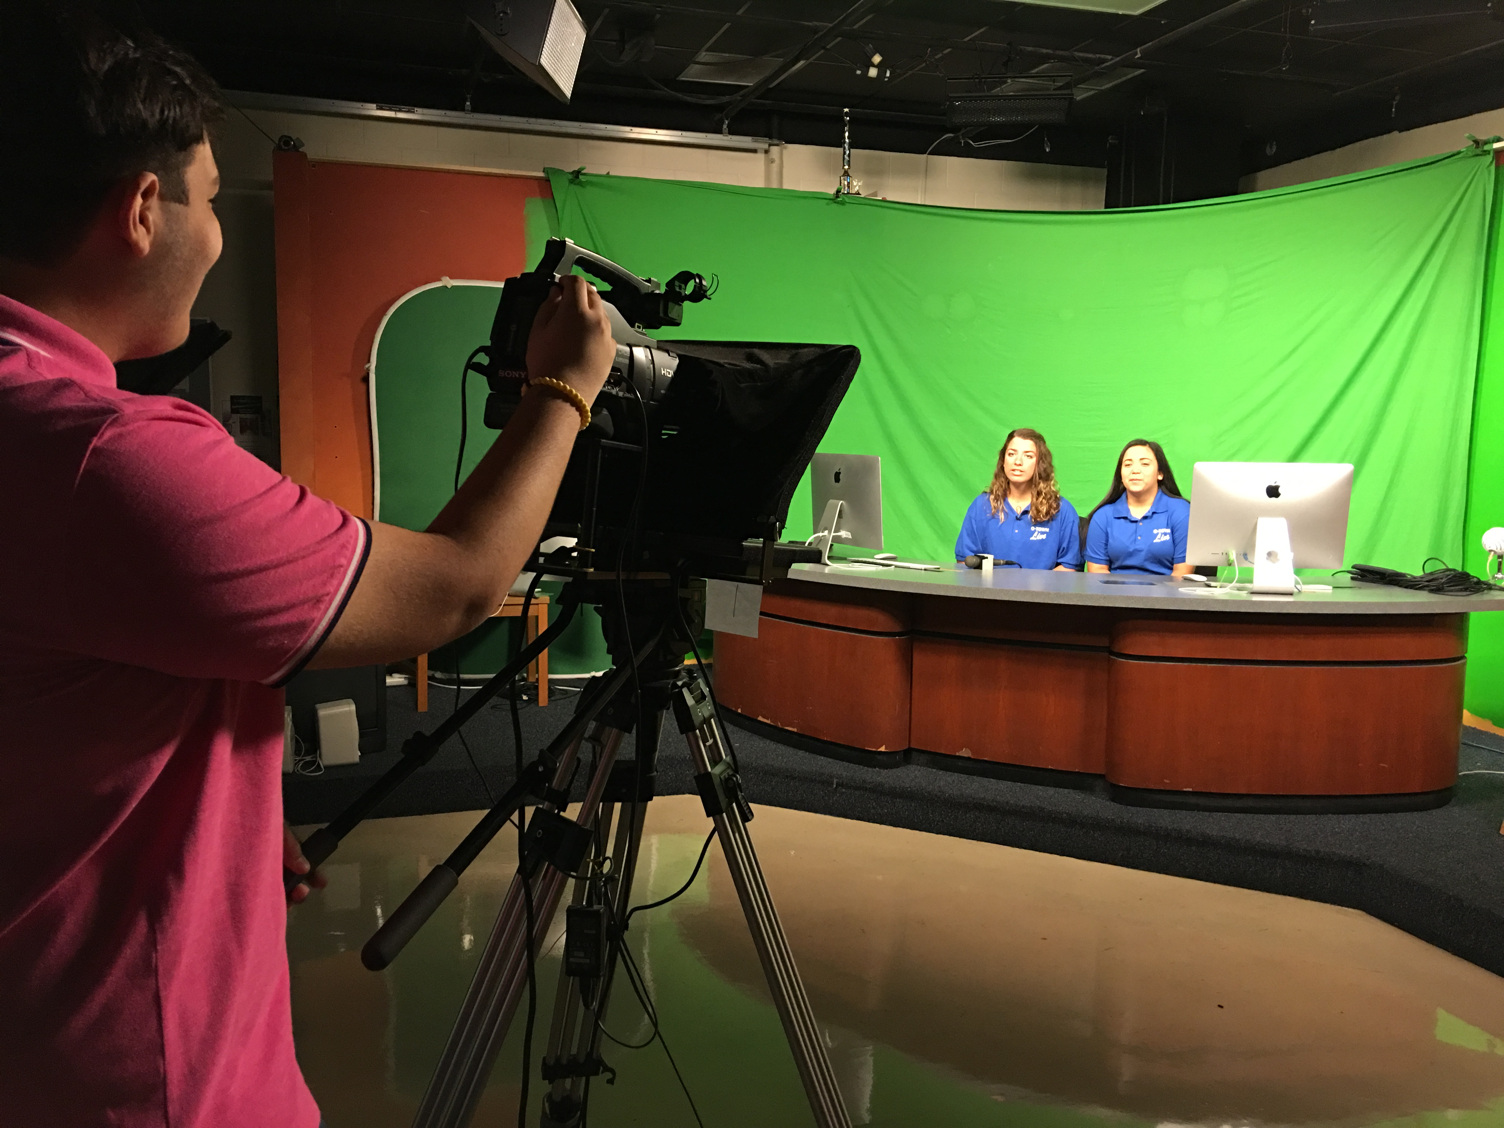
Digital Video Pathway
Digital Video Technology1-6
Open to 9-12
Apple iMac Computers

Slide 16
Digital Video Pathway
Certifications
Apple Final Cut Pro
Adobe Premiere Pro
Adobe After Effects

Slide 17
Web Development Pathway
Foundations of Web Design
User Interface Design
Web Scripting Fundamentals

Slide 18
Business Management and Analysis
Business and Entrepreneurial Principles
Management and Human Resources
Legal Aspects of Business

Slide 19
On the Job Training
Students who meet eligibility requirements can earn elective credit(s) for continuous employment and qualify for either one or two release periods.
Eligibility Requirements:
Maintain employment related to a c.TED Pathway throughout course
2.0 cumulative GPA
Parent Permission
Approval from OJT Coordinator
For more info: eetenje@pcsb.org (Mr. Eeten)

Slide 20
Industry Certifications
Microsoft Office Specialist (MOS)
Word
Excel
PowerPoint
Outlook
Access
Microsoft Expert
Word
Excel
Apple
Final Cut Pro X
Entrepreneurship & Small Business
Web Design
HTML5 & CSS3
Adobe Certified Associate (ACA)
Photoshop
Dreamweaver
Flash
InDesign
Illustrator
Premiere Pro
After Effects
Animate
Security
MTA Network
MTA Security
CompTIA Security Plus

Slide 21
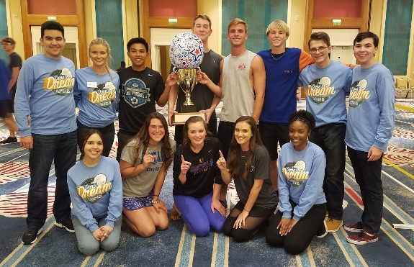
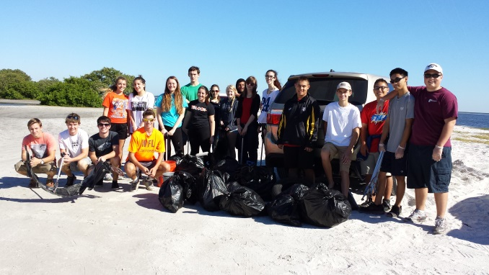
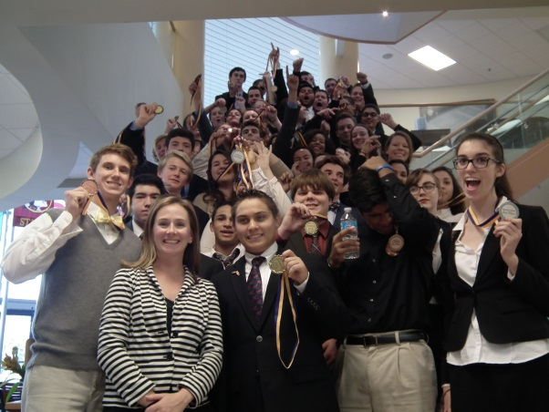
Future Business Leaders of America
Student led organization
Competitions
District, State, Nationals
Field Trips
Fall Motivational Rally
Community Service
Guest Speakers
Fundraising
GOLF TOURNAMENT
For more info:
osceolafbla.weebly.com/
& www.fbla-pbl.org

Slide 22
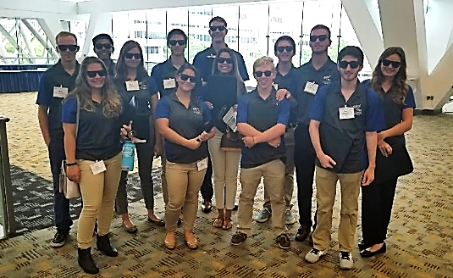
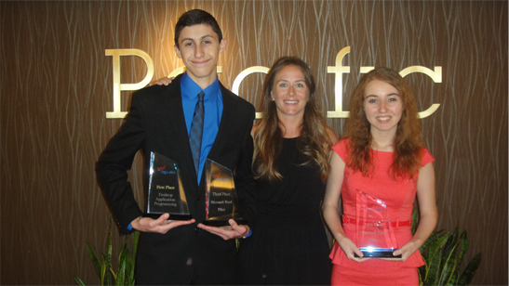
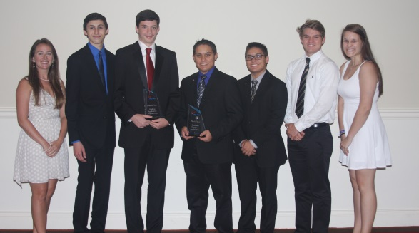
National Winners!
National Winners 2013 – Anaheim, CA
1st place – Matt Cortez – Desktop Application Programming
3rd Place – Matt Cortez – Microsoft Word Expert
5th Place – Ashley Machie – Microsoft Office Excel
National Winners 2014 – Nashville, TN
3rd place – Connor Hill – Database Design and Application
7th Place – Sam Rankin – Desktop Application Programming
National Winners 2015 – Chicago, IL
3rd Place – Connor Hill, Kailey White - Digital Design & Promotion
9th Place – Furkan Memon, Savannah Bedillion, Jonathan Moreno – Digital Video
National Winners 2018 – Baltimore, MD
2nd place – Mackenzie Moreno – Sales Presentation
3rd Place – AJ Heflin, Wyatt Morris, Adriana Hansen – Web Development
Nationals 2020 – salt lake city!

Slide 23
MORE Clubs & Opportunities!
NTHS
Computer Science Club
Next Generation Tech Competition

Slide 24
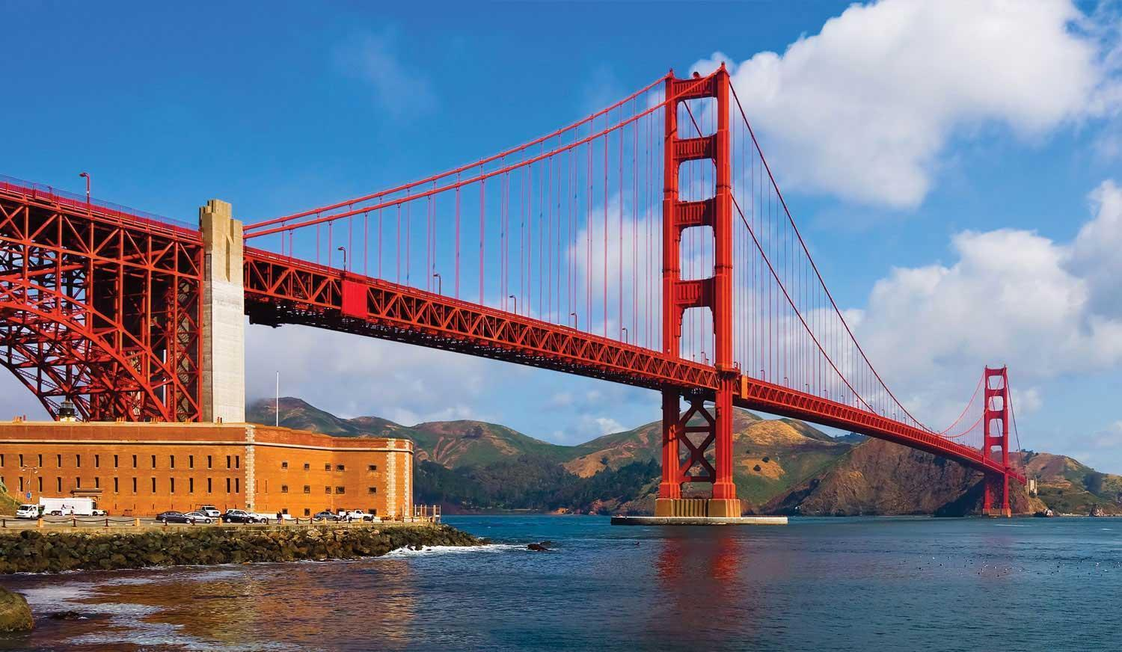
Even MORE!
Travel opportunities – NYC, California
Each year Juniors/Seniors in CTED are invited on a business/technology related field trip!

Slide 25
Contact Us
Mrs. Courtney Thompson
thompsoncou@pcsb.org
DIT
Digital Design
Web Design
FBLA
Mrs. Debbie Rein
reind@pcsb.org
Digital Video Production
Student Television Network
DIT
NTHS
TAs
Mr. Jerry Eeten
Eetenje@pcsb.org
Sports Marketing and Entertainment Management
OJT/DCT
Mr. Jack Mattheus
mattheusw@pcsb.org
Cyber Security
Programming
AP Comp Sci
Computer Science Club
Mr. Christopher Drake
DrakeChr@pcsb.org
DIT
Business Management

